Slide 1

Iberian Blackout 2025
ICER - Reliability Working Group Webinar
June 2, 2026

Slide 2

Topics
System Conditions
  Significance of the incident
  Power system fundamentals
Iberian Blackout
  The incident
  Restauration process
Conclusions

Slide 3
Topics
System Conditions
  Significance of the incident
  Power system fundamentals
Iberian Blackout
  The incident
  Restauration process
Conclusions

Slide 4
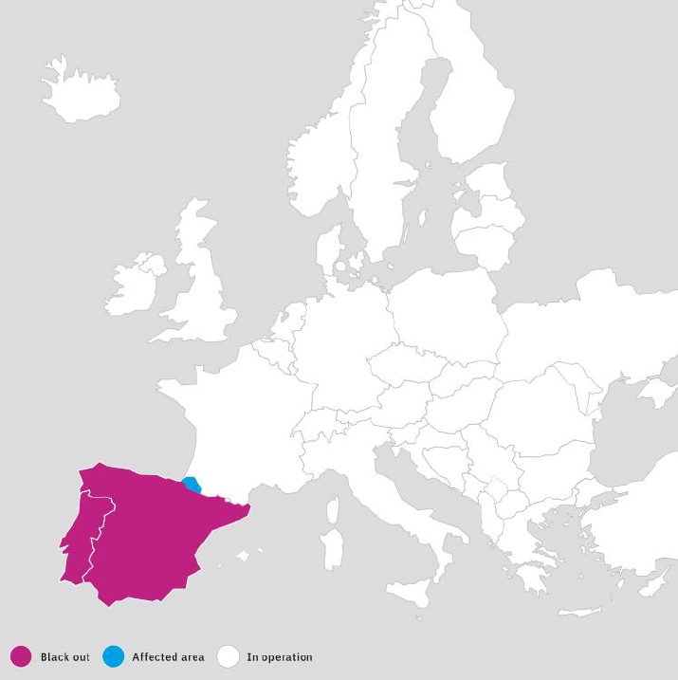
Significance of the incident
On 28 April 2025, at 12:33 CEST, continental Spain and Portugal suffered a blackout.
A small area in the South of France (at the border with Spain) was also affected during a very short period of time.
The rest of the European power system did not experience any relevant disturbance resulting from the incident.
This was the most severe blackout on the European power system in over 20 years, and the first ever of its kind (overvoltage).
It had major repercussions for citizens and society.
Source: ENTSO-E

Slide 5
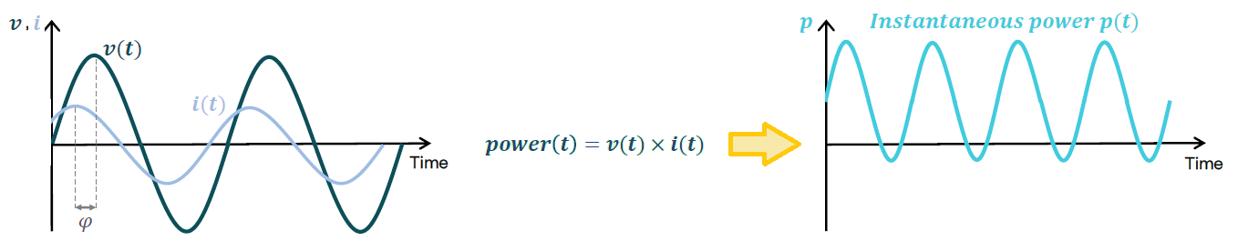
Power system fundamentals
Alternating Current (AC) Power grids stand on the stability of the frequency and voltage.
Without voltage and frequency within pre-determined ranges the grid collapses.
In AC grids the current alternating wave is not always aligned with the voltage. This fact creates Reactive Power (Q) that oscillates between its source and the load with average value 0.
Reactive Power results from electrical components that shift the current wave in relation to the voltage wave thus creating a phase angle 𝝋. These components can either create a lag (inductive) or create a lead (capacitive) -> Power Factor (PF) ≠ 0.

Slide 6
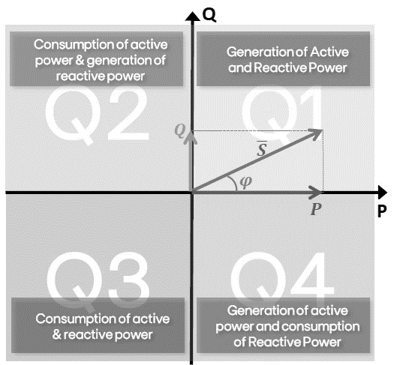

Power system fundamentals
Generation and consumption of power can be in one of 4 quadrants, depending on the generation and consumption of active and reactive power.
Synchronous Generators (SGs) or Inverter Based Resources (IBRs) can generate or consume in one or several of 4 P-Q quadrants, depending on their technical capabilities.
Active power <-> frequency control: Frequency is a systemwide variable and changes with supply/demand balance variations.
Reactive power <-> voltage control: Voltage is a locally defined variable and strongly depends on reactive power flows.
The Iberian Blackout was the first ever of its kind (overvoltage -> voltage control).

Slide 7
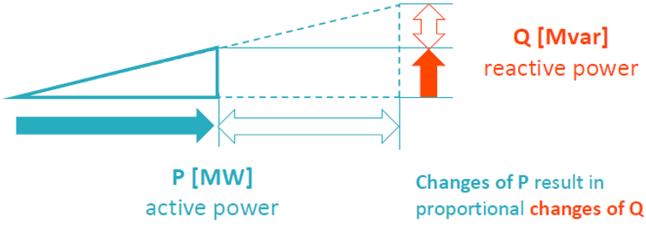
Voltage Control – 2 basic modes
Mode | Examples | Action
Fixed Power Factor | cos 𝝋 = 0.95 2P → 2Q | Does not explicitly regulates voltage. P and Q are always in the same ratio to each other (Q depends on P)
Mode | Dynamic | Action
Fixed Power Factor | No | Doesn’t really control voltage. P and Q are always in the same ratio to each other
Dynamic voltage control | V = 0.97 pu → +Q V = 1.03 pu → -Q | Provides voltage regulation within the generator capability limits, with a centralized setpoint (Q does not depend on P)
With fixed power factor, Q is dependent on P, but not on voltage. Changes of P result in proportional changes of Q.
Source: ENTSO-E

Slide 8
Network Planning
System assets:
  Inductive elements absorb reactive power and lead voltage to decrease locally.
  Capacitive elements supply reactive power and lead voltage to increase locally (capacitive behavior is less common in loads, but present in network elements).
Voltage disturbances do not necessarily involve frequency changes and hence do not involve inertial problems. However, if not properly managed, voltage disturbances may trigger cascading events, propagate, affect system stability and develop into frequency faults.
Network planning and operation require balancing operational measures, such as generator redispatch and ancillary services, with long-term investments in dedicated voltage-control assets, such as shunt reactors or synchronous compensators, managed directly by system operators. Can some of these investments be in regulated assets?
To some extent, this dilemma is similar from that faced in network development planning: optimize between capital expenditures (CAPEX) and operational expenditures (OPEX).
Example: Redispatch Units
More OPEX
More CAPEX
Example: Long-term investments

Slide 9
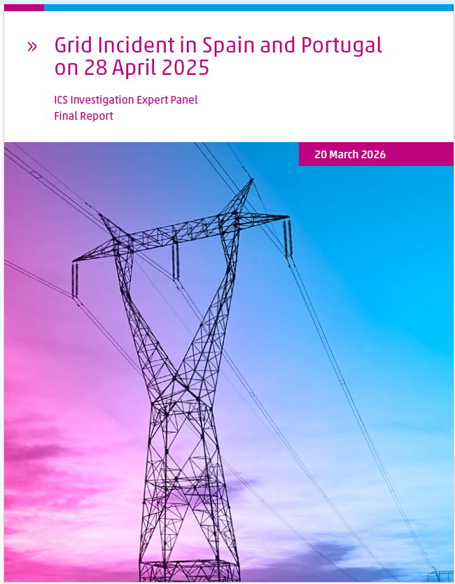
Topics
System Conditions
  Significance of the incident
  Power system fundamentals
Iberian Blackout
  The incident
  Restauration process
Conclusions

Slide 10
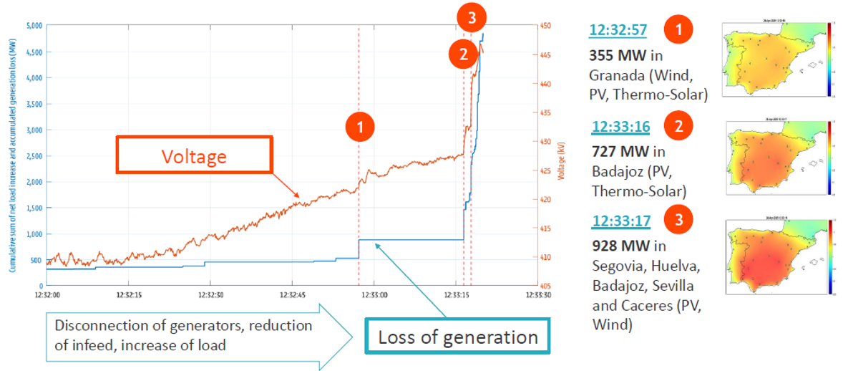
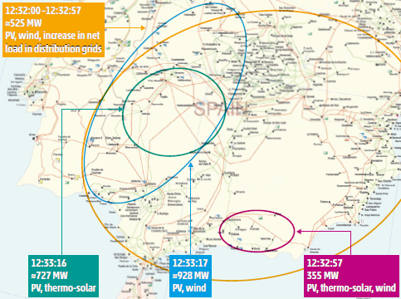
Three major tripping events in South-West Spain
Evolution of cascade of overvoltage disconnection of generators.
Until 12:33:18 no disconnection in Portugal.
Source: ENTSO-E

Slide 11
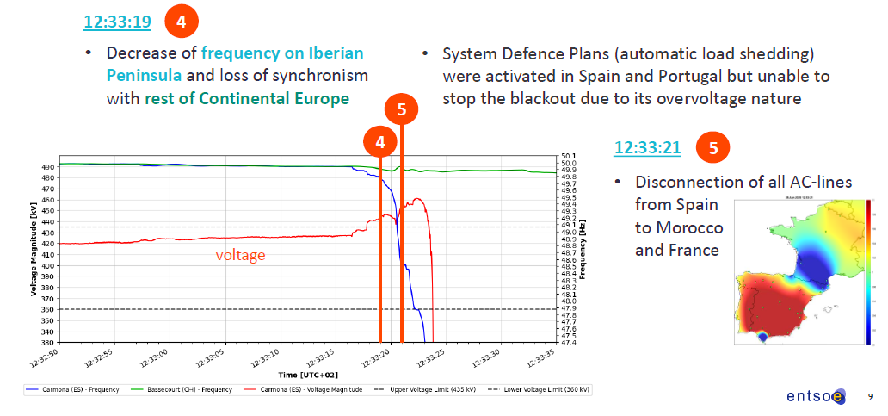
Voltage and frequency evolution during the incident
Source: ENTSO-E

Slide 12
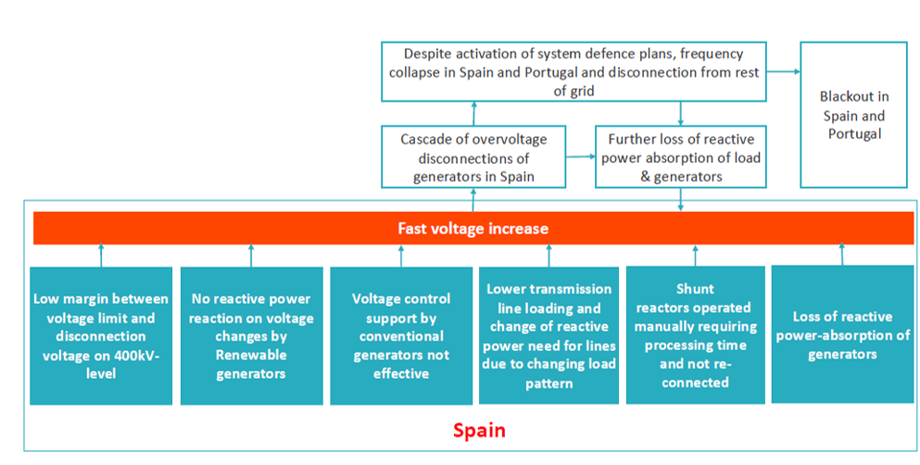
Simplified Root Cause Tree
Not a single root cause, but a combination of several key factors resulted in the system failure.
The Full Root Cause Tree, with 39 steps, can be consulted in the official report
Source: ENTSO-E

Slide 13
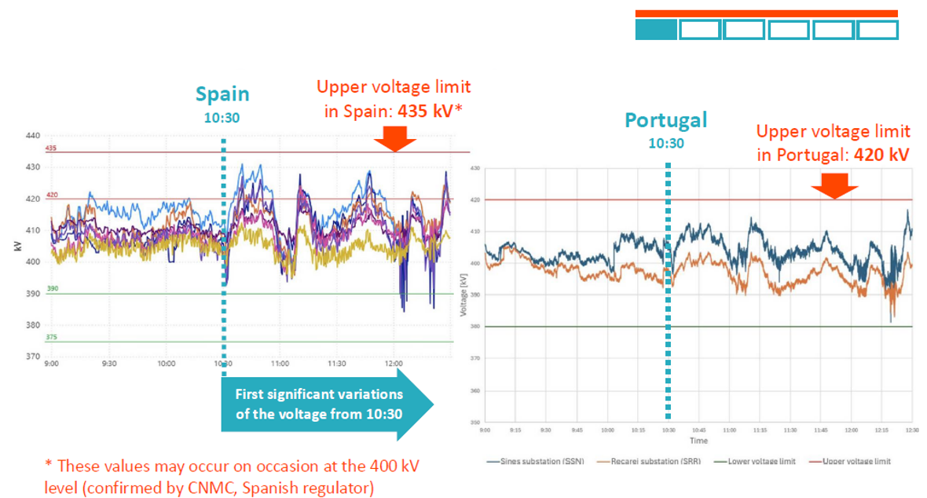
Low margin for voltage disconnection
Low margin between voltage limit and disconnection voltage on 400 kV level in Spain
Simplified Root Cause Tree
Voltage evolution at the main 400 kV transmission substations in Spain
Source: ENTSO-E

Slide 14
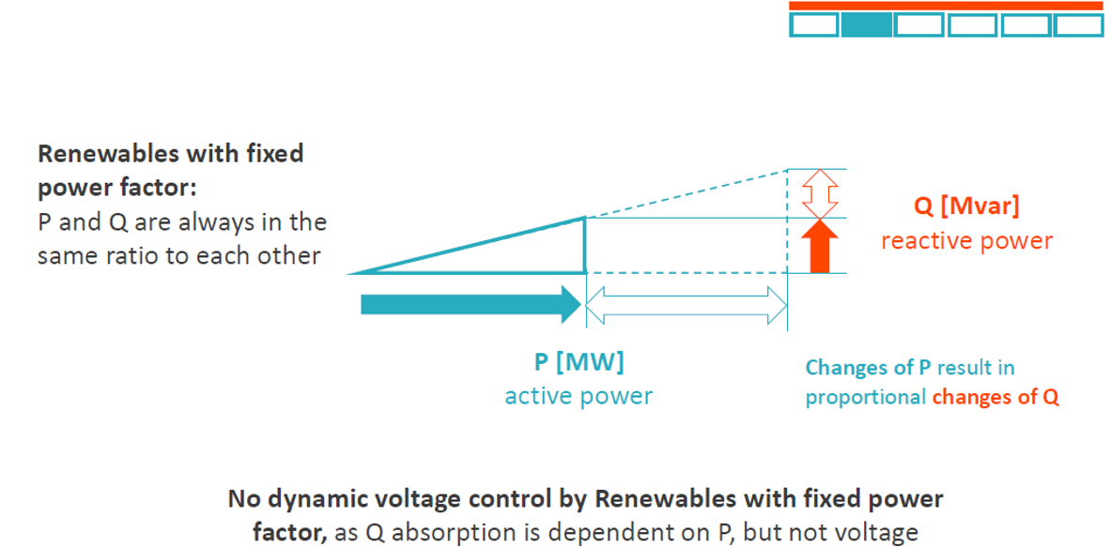
Reactive power reaction
No reactive power reaction on voltage changes by Renewable generators in Spain
Simplified Root Cause Tree
Source: ENTSO-E

Slide 15
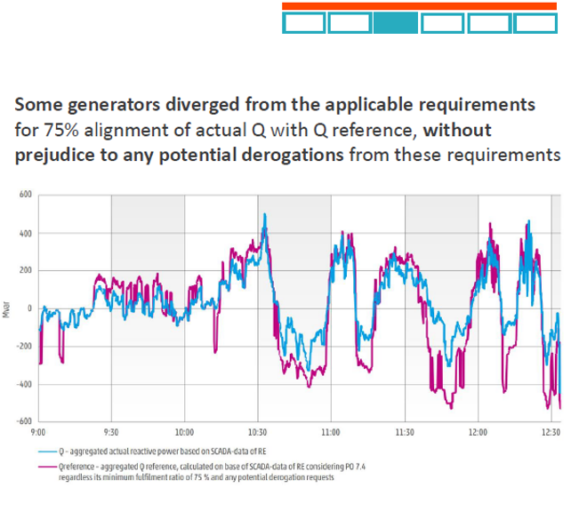
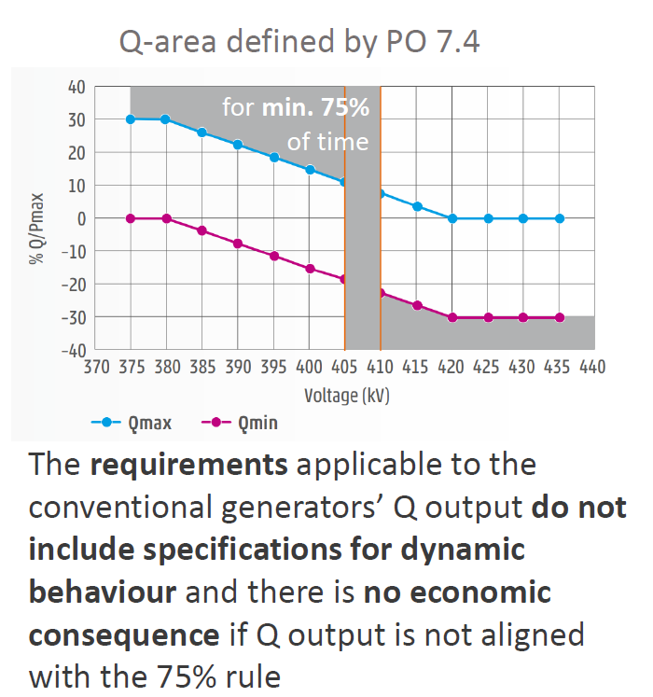
Voltage control
Voltage control suport by conventional generators not effective in Spain
Simplified Root Cause Tree
Source: ENTSO-E

Slide 16
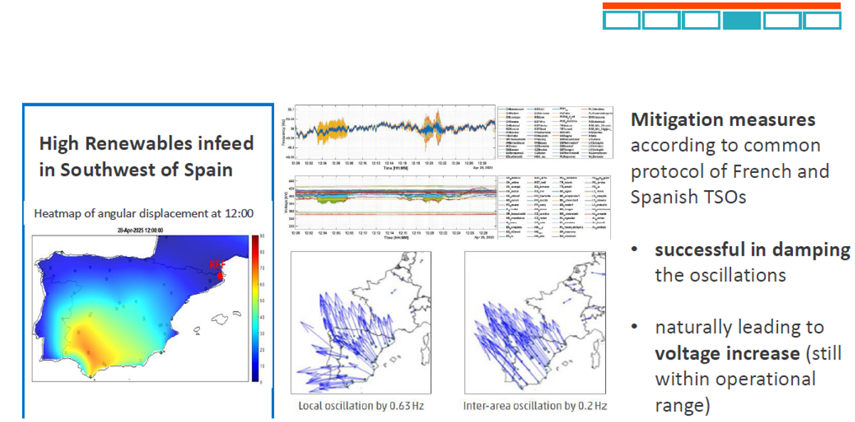
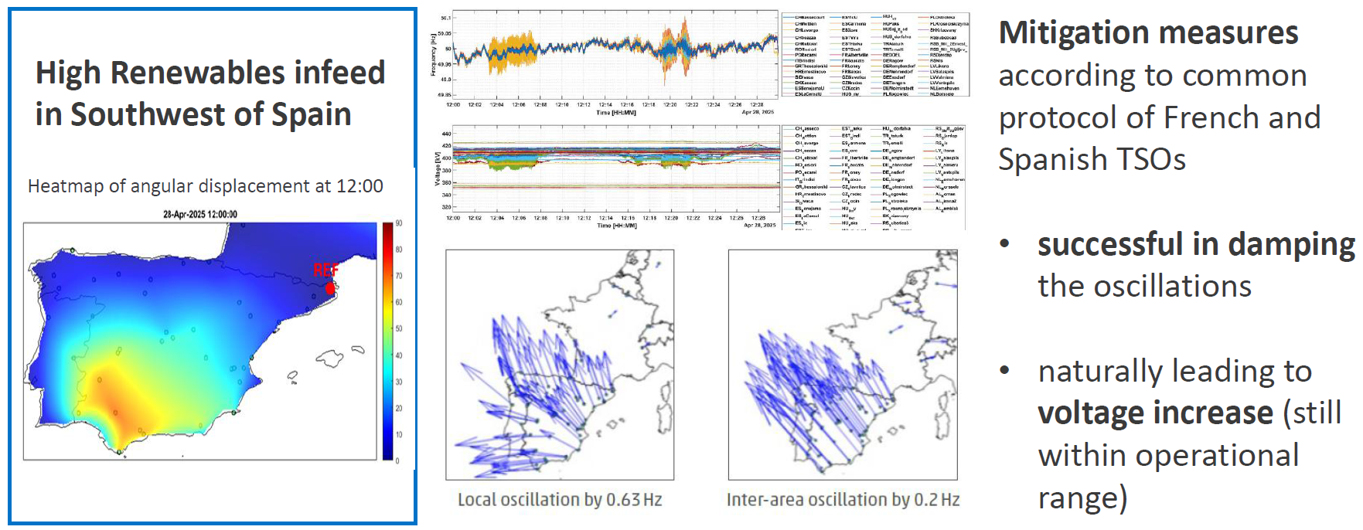
Mitigation measures
Lower transmission line loading after mitigating oscillations
Simplified Root Cause Tree
Source: ENTSO-E

Slide 17
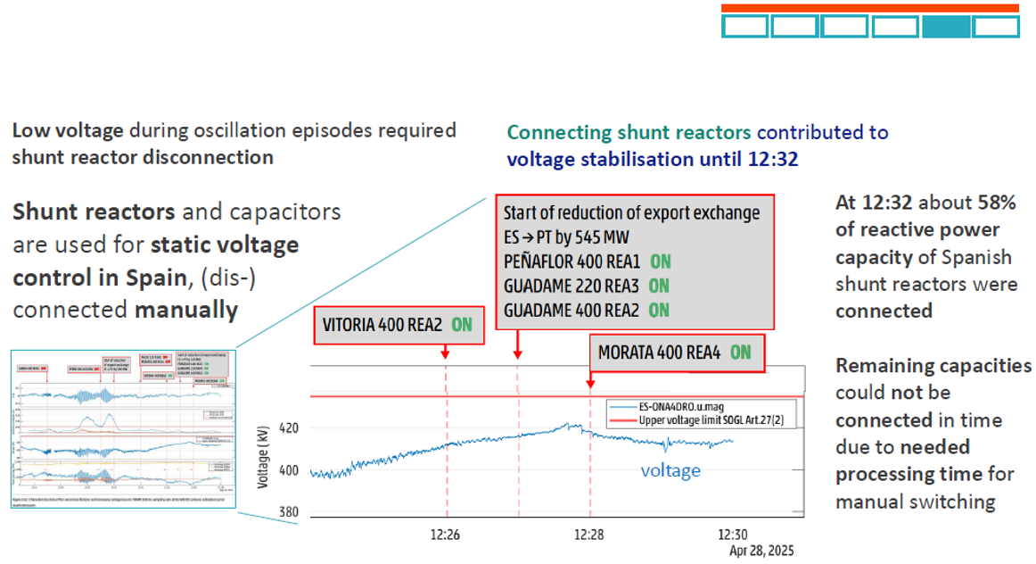
Manually operated devices
Shunt reactors operated manually – requiring processing time – and not re-connected
Simplified Root Cause Tree
Source: ENTSO-E

Slide 18
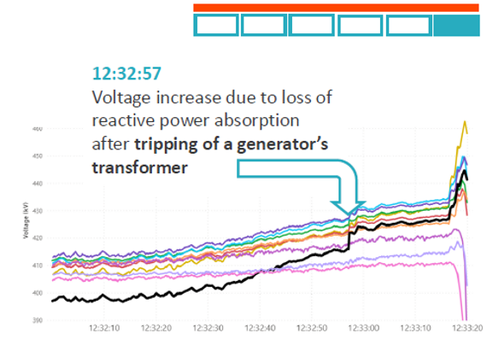
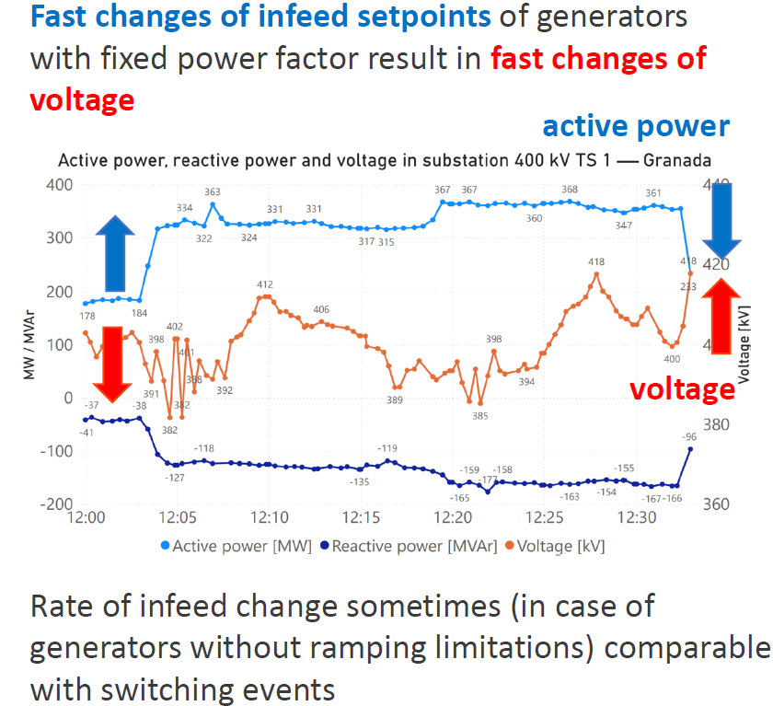
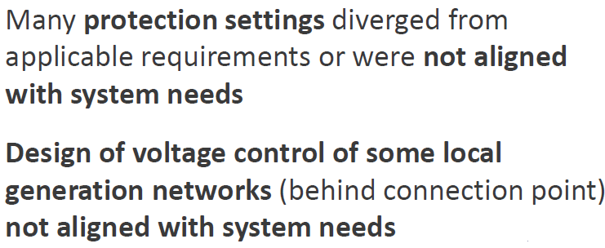
Loss of reactive power absorption of generators in Spain
Simplified Root Cause Tree
Voltages in a set of 400 kV PMUs. Particularly steep rise registered in PMU TAB4LIT
(Andalusia, southern Spain), colored black in the figure
Source: ENTSO-E

Slide 19
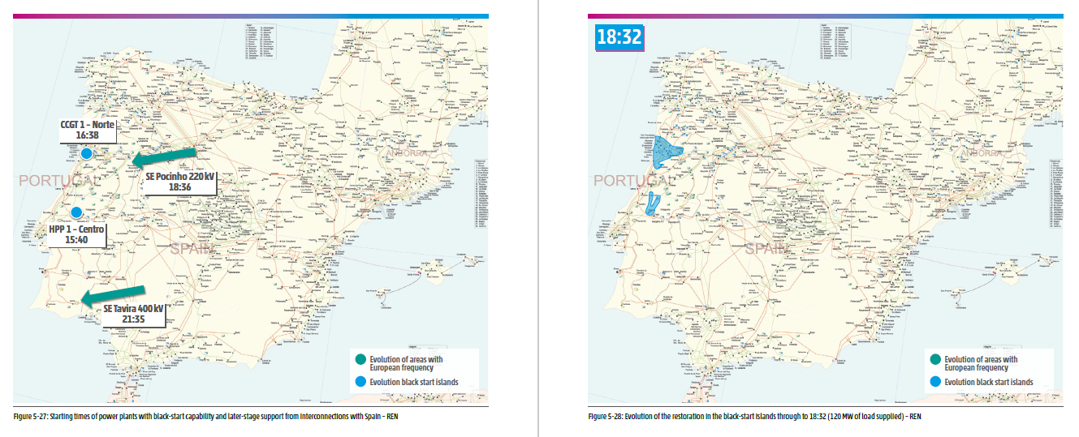
Restauration Process – Portugal: without interconnections
120 MW (2% of the previous day’s peak demand)
Source: ENTSO-E

Slide 20
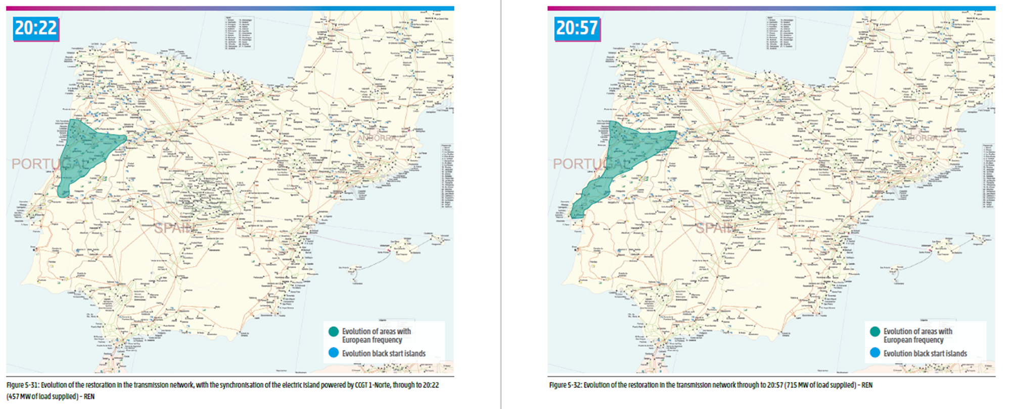
Restauration Process – Portugal: with interconnections
With interconnections
The restoration starts to evolve faster
457 MW (8% of the previous day’s peak demand)
715 MW (12% of the previous day’s peak demand)
Source: ENTSO-E

Slide 21
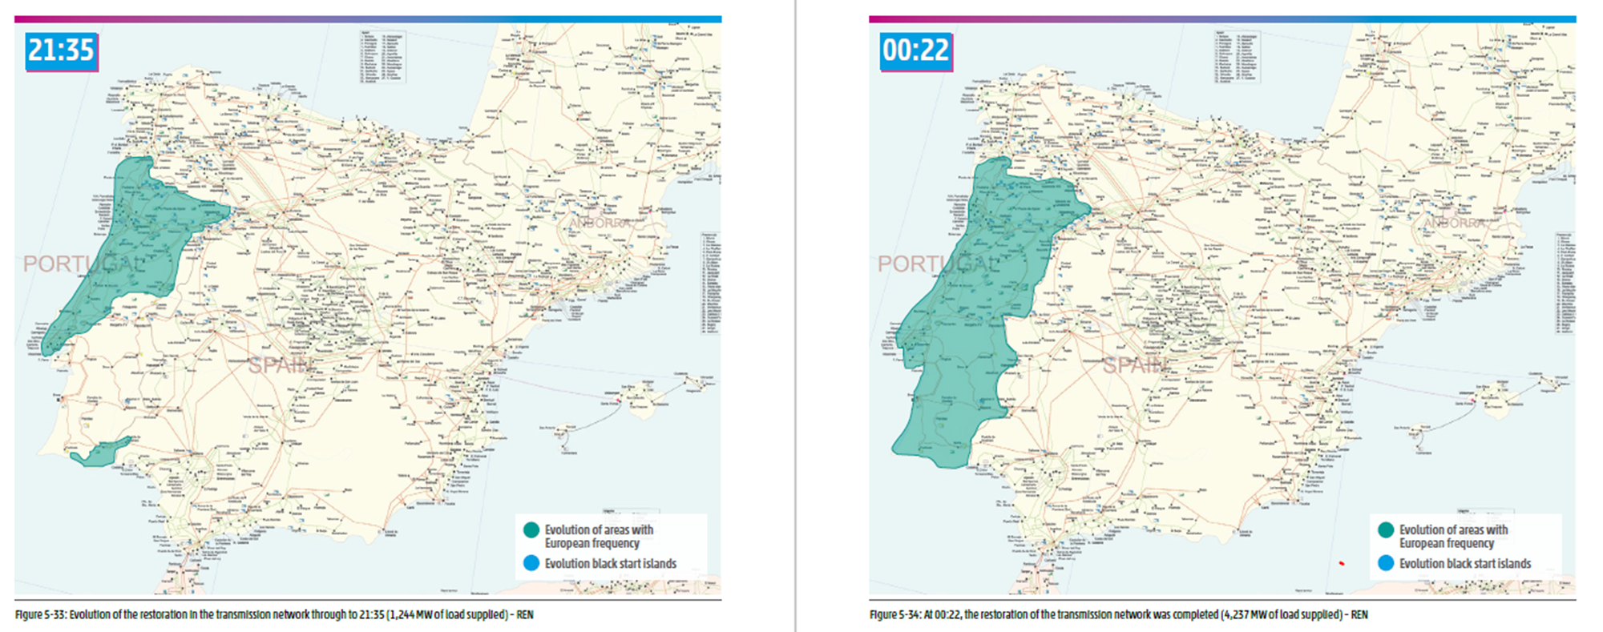
Restauration Process – Portugal: 100% grid restoration
1 244 MW (21% of the previous day’s peak demand)
4 237 MW – Transmission grid restoration completed
Source: ENTSO-E

Slide 22
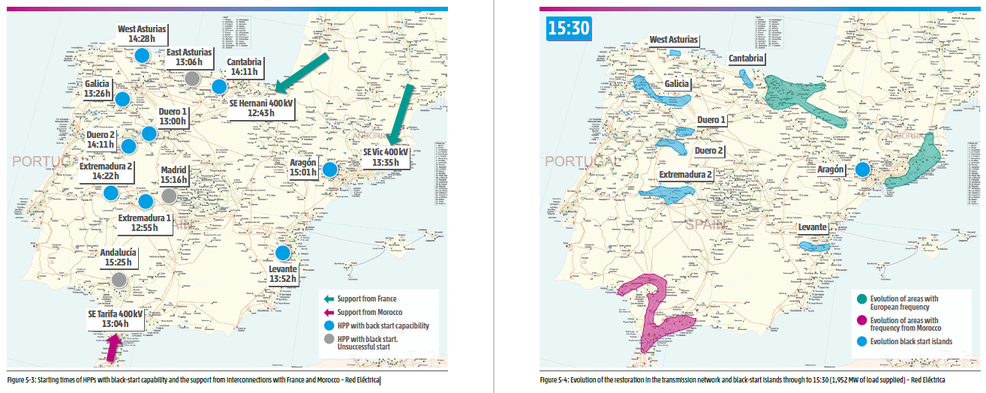
Restauration Process – Spain: support from interconnections
1 952 MW (7% of the previous day’s peak demand)
Source: ENTSO-E

Slide 23
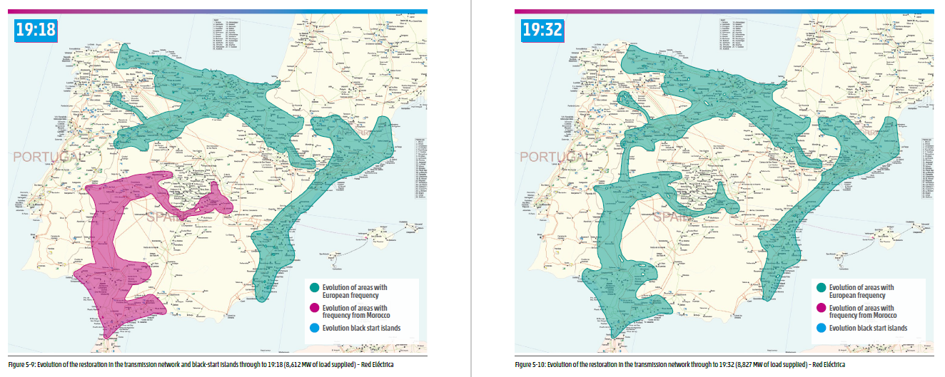
Restauration Process – Spain: support from interconnections
8 612 MW (32% of the previous day’s peak demand)
8 827 MW (33% of the previous day’s peak demand)
Source: ENTSO-E

Slide 24
Topics
System Conditions
  Significance of the incident
  Power system fundamentals
Iberian Blackout
  The incident
  Restauration process
Conclusions

Slide 25
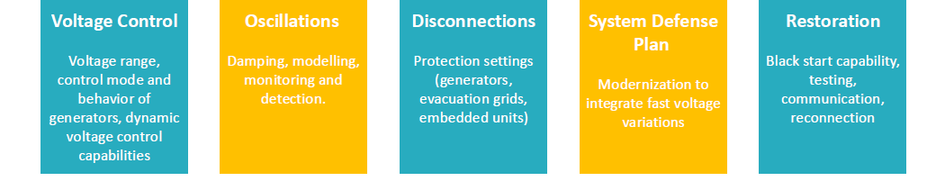
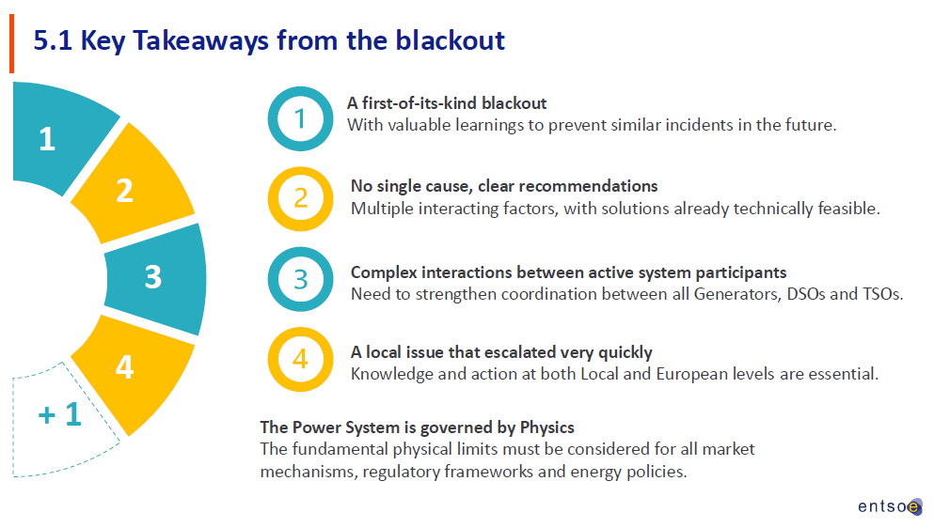
Conclusions
The power system is governed by Physics
Source: ENTSO-E

Slide 26

Thank you!
Rua Dom Cristóvão da Gama, 1 - 3º
1400 - 113 Lisboa
Portugal
Telefone: 213 033 200
E-mail geral: erse@erse.pt

